Slide 1


ASP.NET vNEXT
&
development tools
Marco De Nittis
marco.denittis@gmail.com
@mdnmdn

Slide 2
Agenda
Overview
.NET Core / ASP.NET vNext
New Build Tools
Visual Studio 2015 + Demo
Multiplatform Development Tools + Demo

Slide 3
What?
ASP.NET vNEXT (aka ASP.NET 5)
.NET Core (aka .NET 5)
MVC 6
Visual Studio 2015
OmniSharp

Slide 4

Open Source!
Are you sure?
!

Slide 5
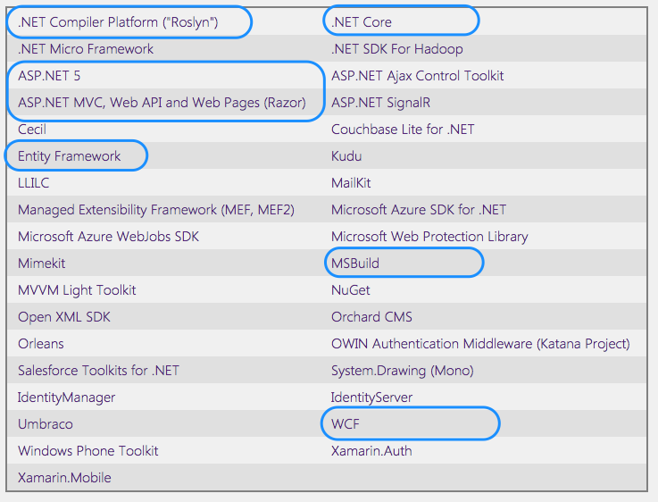
http://www.dotnetfoundation.org/

Slide 6


.NET Core
aka .NET v5
Subset of .NET v4.5.x
Open Source
Cross platform by design
Modular
Cloud Optimised
speed/memory

Slide 7
.NET Core
Run on User space
No more admin install
Multiple versions
Self contained… with the app!!!
Roslyn compiler
in memory, on the fly compile!
Native compile! (only for Win10)

Slide 8

ASP.NET vNext
aka ASP.NET 5
Modular
System.Web.dll bye bye
OWIN based
Dynamic development (recompiles on the fly)
Web Form no more
and maybe VB.NET
Run on: .NET Core, .NET 4.5.x, mono, …
}
Update speed
}
Still supported on 4.6

Slide 9
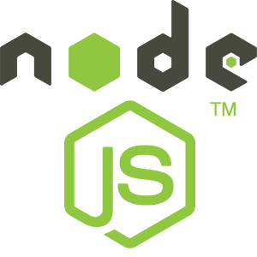
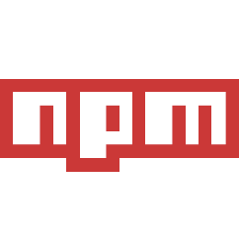



ASP.NET vNext
JS* everywhere
node.js build tools
NPM - Node Package Manager
Gulp/Grunt - Tasks runner
Bower - frontend JS pkg manager

Slide 10
MVC 6
Run on vNext
News:
Tag Helpers
View Components
MVC / WebAPI unified controller
Dependency Injection OOB
<li>
@Html.ActionLink("Home", "Index", “Home”)
</li>
<li>
<a controller="Home" action=“Index">Home</a>
</li>

Slide 11

TOOLS

Slide 12
NuGet
.NET full fledged package manager
Manage App dependencies
Manage .NET Runtime dependencies!
.NET Core + .NET 4.5.x + mono + …
Modular framework!

Slide 13
Node.JS
JS server side engine
Used on vNext Build Pipeline
Base of “modern” web development tools
Runtime for the other build tools
PRO:
Easy extendable
Thousand of ready to
use extensions

Slide 14
Node Packager Manager
aka NPM
Nuget for node.js
Javascript package repository:
https://www.npmjs.com/
Used to install build extension, ex:
Assets bundler
CSS preprocessor
…

Slide 15
Bower
Client side JS package manager
Nuget for Web App JS + CSS
Not a clone of NPM
Cleaner & streamlined approach

Slide 16
Gulp / Grunt
Task runners
Integrated in the Build Pipeline
Preprocess / post process actions
Gulp by default
OOB extension with NPM
Easy to customization with JS

Slide 17

Visual Studio 2015
Support all web projects
vNext
ASP.NET 4.x (also Web Forms)
Workflow integrated with new tools

Slide 18
TOOLS
Bundled in
Visual Studio 2015!

Slide 19

VS 2015 RC - Demo
WORK

Slide 20
New Tools
Cross platform by design
“Modern” development tools
OmniSharp
Visual Studio Code

Slide 21

OmniSharp
Family of Cross Platform dev tools
Open Source
Intellisense!
To enable a great .NET experience in YOUR editor of choice

Slide 22
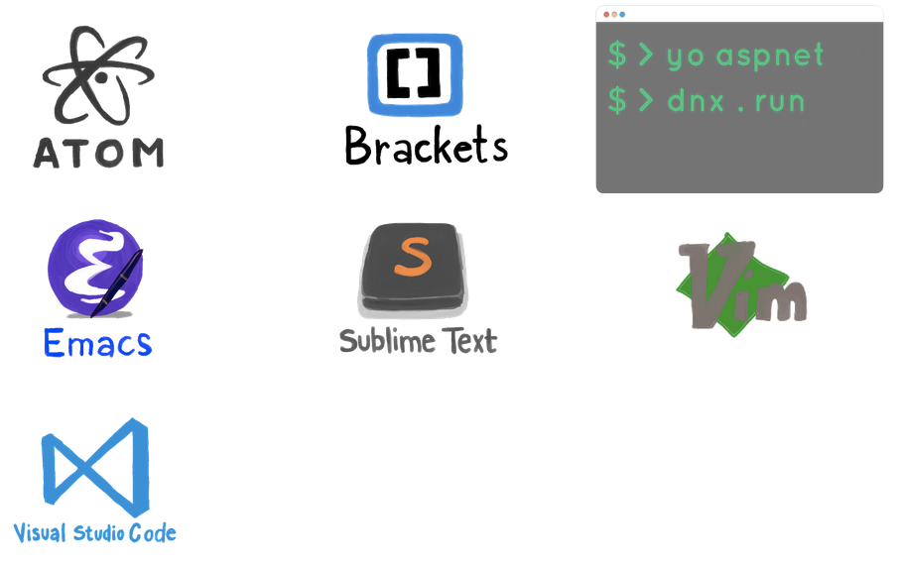

OmniSharp

Slide 23
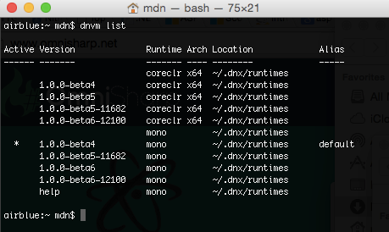
CLI - DNVM
DNX -> .NET Version Manager
Select / install / update .NET Runtime engines

Slide 24
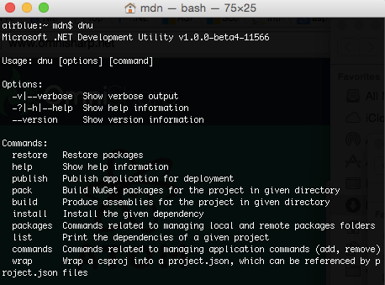
CLI - DNU
DNU -> .NET Dev Utilities
NuGet
Build
Publish

Slide 25
CLI - DNX
DNX -> .NET eXecution Environment
Run Console app
Run Web App
Customizable commands
ex: Web App Scaffolding

Slide 26
Yeoman
Scaffolding CLI tool
Create new project from template
.NET Templates
Console
MVC
Nancy

Slide 27
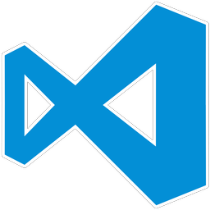
Visual Studio Code
By Microsoft!
Based on Atom.io editor (from GitHub)
JS Core
Support .NET and node.js apps
In preview:
Sorry, no debugging for .NET

Slide 28
OS X OmniSharp - Demo
WORK
REALLY!

Slide 29
Conclusions
Cross Platform
Modular
Open -> Open Source

Slide 30
Conclusions 2
Is really cross platform?
Is ready for production?
Not yet
Still not yet

Slide 31

THANK YOU
Questions?
Marco De Nittis
marco.denittis@gmail.com
@mdnmdn

